Slide 1
Identify copyist of “Avila Bible” with Decision Tree

Slide 2
Abstract
This project uses the data extracted from 800 images of the “Avila Bible”, a giant Latin copy of the whole Bible produced during the XII century between Italy and Spain.
The Decision Tree model is used to conduct the analysis and prediction.
The related graphs and tables are showed to visualize the data, experiment results, and model capacity.
The main goal of the project is to predict who is the copyist of the given a part of content.

Slide 3
Realistic meaning of this research:
Computer-based techniques of analysis, whose aim is that of providing new and more objective ways of characterizing medieval handwritings and distinguishing between scribal hands, has been more and more attention in the context of paleographic studies.
In this project, we introduce a pattern recognition system which is fed to a global set of “texture” features, tries to solve a typical paleographic problem.
The system is not only useful in paleographic area but also in other image recognition scenarios. Although, end to end deep learning models achieve significant performance in the image recognition, but the proposed system is still a complementarity of the deep learning model. Since it has several advantages such as it is not necessary for too much computation resource.

Slide 4
Background
The pages of “Avila Bible” written by each copyist are not equally numerous. Each pattern contains 10 features and corresponds to a group of 4 consecutive rows.
The prediction task consists in associating each pattern to one of the 12 copyists(labeled as: A, B, C, D, E, F, G, H, I, W, X, Y).
The training set containing 10430 samples, and a test set containing the 10437 samples.
Class distribution(training data set):
Decision tree model is a classic statistical learning method to conduct multi-class classification problem.
A | B | C | D | E | F | G | H | I | W | X | Y
4286 | 5 | 103 | 352 | 1095 | 1961 | 446 | 519 | 831 | 44 | 522 | 266

Slide 5
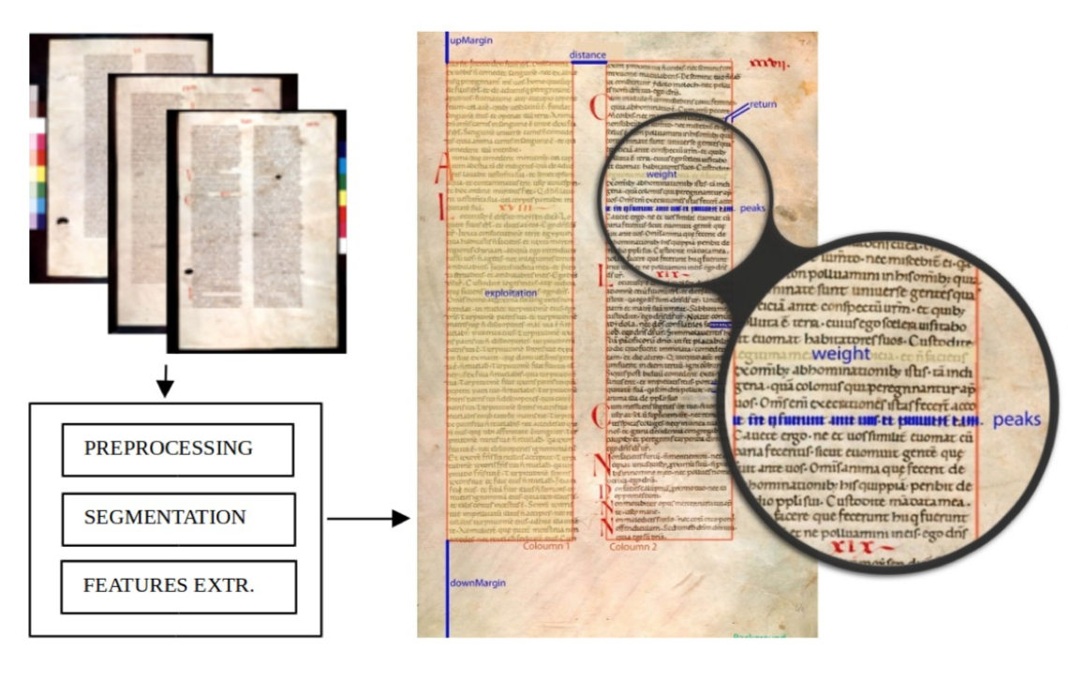
Data Description and Visualizatoin
Data source: C.De Stefano(2018), UCI Machine Learning Repository [http://archive.ics.uci.edu/ml]. Irvine, CA: University of California, School of Information and Computer Science.
Variables:
Intercolumnar distance: distance between columns
Upper margin: upside value
Lower margin: downside value
Exploitation: column exploitation coefficient (the number of black pixels/the total number of pixels in the column)
Row number: number of rows in the column
Modular ratio: estimates the dimension of handwriting characters
Interlinear spacing: the distance in pixels between two rows
Weight: a measure of how much a row is filled with ink
modular ratio/ interlinear spacing
Peak number: the number of peaks in the horizontal projection
histogram of rows

Slide 6
Graphs and plots
The data have has been normalized, by using the Z-normalization method.
Get rid of outliers:

Slide 7
Variables Distribution Visualization:

Slide 8
Variables Correlation Matrix Plot:

Slide 9
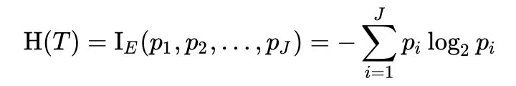
Methodology
Decision Tree: A decision tree is a flowchart-like structure in which each internal node represents a "test" on an attribute each branch represents the outcome of the test, and each leaf node represents a class label.
Information Entropy：
Advantages: Easy to understand and analysis.
Disadvantages: Overfitting.

Slide 10
Results

Slide 11
F-score for each class:
Overall F score: 0.97

Slide 12
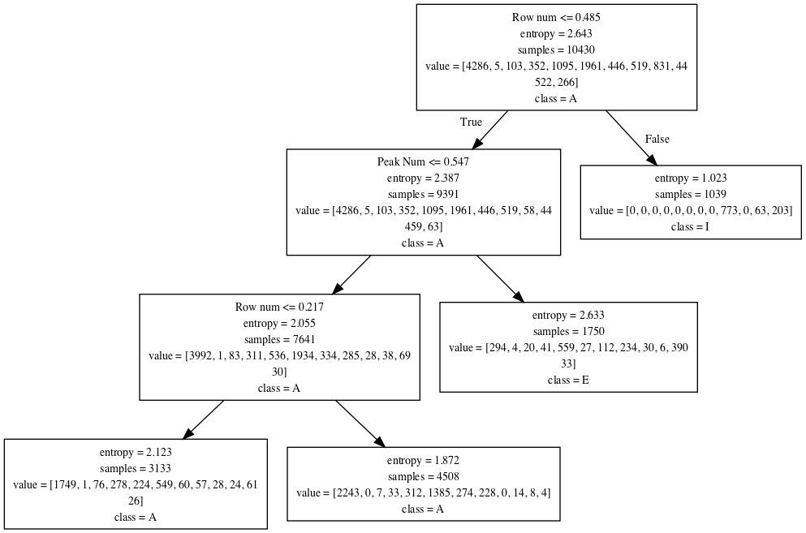
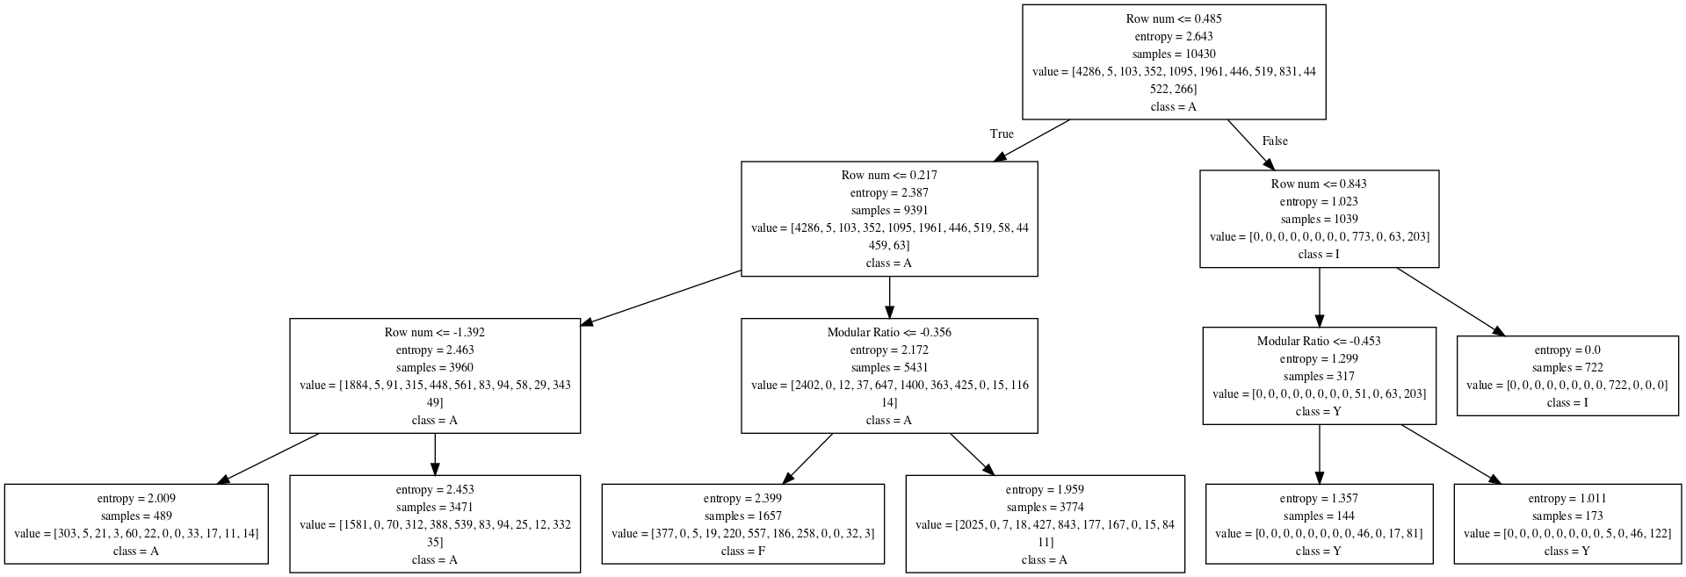
After Pruning

Slide 13
Conclusions
From the first results plot, the train and test accuracy increase with the max depth of decision tree increases. But when depth is larger than 10, the influence on the test accuracy is very small. We choose the max depth=14 of the decision tree for the final model, which is a balance between efficient and effective. The final average of 12 classes F score is 0.97. After pruning the tree, the final average F score is 0.95, slightly lower score, but increasing the speed.
The decision tree model gives a good prediction performance on the copyist identification problem by using the features extracted from the texts. If the depth of the tree is too large, the model may meet overfitting problem. Tune the model and choose both efficient and effective model is necessary.
The row number variable is the first node in the decision tree, which means that this feature is most import for the copyist classification.

Slide 14
Study Strengths and Limitations
Strengths:
The decision tree model is well-suited for the multi-class classification problem.
The model complexity can be controlled by max depth of the decision tree.
Generated Tree can be easy to understand and analysis.
Large scale dataset is suitable.
Limitations:
Easy to be overfitting.
Information entropy may have some bias.
Further ensemble models(Random forests model, Xgboosts model) always perform better than single tree-oriented model.

Slide 15
Future Study and Implications
Implications:
The rank of features in terms of the importance.
The hyperparameters such as max depth of the decision tree is important for the final performance of the model.
The significant features are row numbers, exploration, and modular ratio/ interlinear spacing. These features are most representative and can better express the writing habits of the different copyist.
Future Study:
Other model such as Random Forests, Logistic Regression can be used and compared with the current Decision Tree model.
Feature Engineering can be used to further enhance the model performance.

